Slide 1
HBS Department Updates Monday Sept 27, 2021
Time | Agenda Item | Objective | Presenter
4:00p - 4:15p | Welcome, Highlights & Upcoming Events | Welcome Caring Moments “Speaking Up” Moments Announcements | Dr. David Chiu
4:15-5:00p | HBS Updates | Telemetry (Expansion and Utilization) Nursing Requests Med –Specialty Liaisons Daily Operational challenges and Proposals | Dr. Chizoba Nwosu
5:00–5:30PM | Pregnancy and COVID | Overview of Co-Management of patients | Dr Chizoba Nwosu Dr David Chiu Dr Christina Schroeder Dr Trevor Miller
5:30-6: 15PM | Health Connect / SNF Updates | Medication Reconciliation Update POLST on HAIKU | Dr Sean Shargh Dr. Phong Vo
6:15PM –6:30P | Manager’s updates | Parking permit for Fremont Fit testing Revision of COVID Testing guidelines | Kris De Guzman

Slide 2


Speaking Up & Caring Moments
Consider sending an ecard through Kaiser to someone who has been kind, compassionate, or innovative (to give a few examples):
https://caringmoments.kaiserpermanente.org/ecard/
https://caringmoments.kaiserpermanente.org/ecard/

Slide 3

Celebrations

Slide 4

September Birthdays
Anly Tsang 2nd
Sandeep Lal 22nd
Sean Shargh 24th

Slide 5

HBS Family Additions

Slide 6
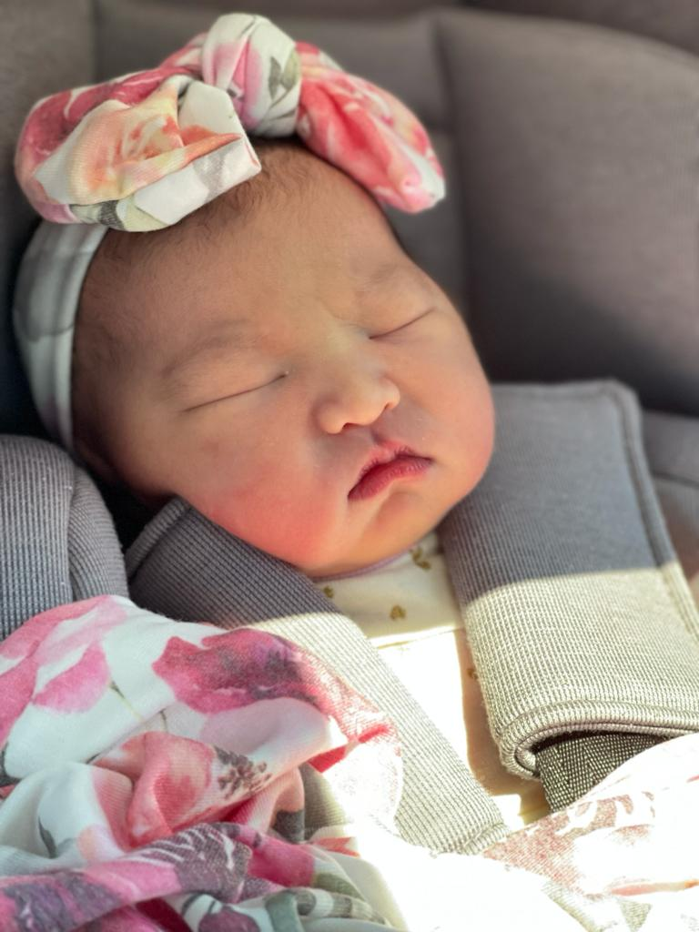

Chloe Huynh

Slide 7

Physician Recognition

Slide 8
Dr sherfong gee
Wanted to thank and recognize Sherfong for doing a paracentesis for me late in the day! I asked her around 3:30 and she graciously offered her help.
Thank you so much Sherfong for staying late on a long weekend to help me.
Anima

Slide 9
Dr Douglas Boakye
I want to acknowledge Dr. Boakye for his attentiveness to a pt/family.
This family questioned an early discharge. However, it was unfortunate that while pt was well @discharge, he experienced a temp later after arriving home and had to return to ER.
In speaking with Dr. Boakye about the family’s concerns, he shared with me that prior to discharge, he’d had actually sat with patient and fed him his breakfast. Dr. Boakye also happily agreed to check in with the dtr to discuss this prior discharge.
I want to bring attention to Dr. Boakye’s compassion and caring manner in these trying times.
His manner of treating every pt as if they are his family goes a long way!
Patients and their families really appreciate the exceptional experience.
Sincerely, Anita

Slide 10
Dr Abhijan Banerjee
Sharing KUDOS from Mary Ann for Dr. Banerjee. He inherited a very busy assignment and according to Mary Ann, crushed it! He did a great job quickly assessing patients and identifying opportunities for discharge. Want to acknowledge and recognize his fantastic effort!
Warmly
Irina

Slide 11
Dr Mark Andre
Kudos to Dr Andre , for his excellent collaboration with Cardiology and Cardiac Cath team
Pt was supposed to be discharged on Monday 9/20 for Cath , but Dr Andre made it happened to transfer patient today 9/18 and Cath will be done later today
To Kristy RN and Peigi Li RN , for being efficient to complete all transfer barriers in a timely manner , which includes coordination with the Lab and follow through lab result and Heparin bolus etc.
They were able to transfer patient before her scheduled procedure
Great Teamwork!
From Lily Posadas RN, BSN

Slide 12
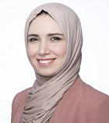

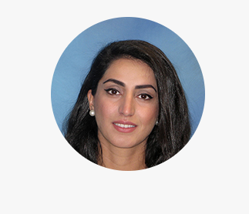
New HBS Pool Providers
Dr. Shahad Al Chalaby, MD
Dr. Gurpreet Singh, MD
Dr. Alaha Wahab, MD

Slide 13

HBS Updates
September 27, 2021

Slide 14
Voice of the Physicians
Any other concerns ?

Slide 15

HBS Dept. Meeting Update Dr Nwosu
9/27/2021

Slide 16
Request from Nursing to HBS
Communication with families: MDs to try and accommodate families request to be called at specific time. (Nurses are aware that most phone calls typically happen in the afternoon between 12 and 5PM)
RN notification regarding change in medication especially if those are made after MDR
Nurse Recognition: Please send emails to nurse managers for RN who have gone above and beyond. (They are working on uplifting nurse morale and recognition)
Review of SLN Level of Care Guidelines will be taking place soon- MDs to send it specific requests or clarification so it can be incorporated into the updated guideline

Slide 17

Medical Subspecialty Liaisons
GI- Eva Chen
Cardiology –Tram Nguyen (David)
Nephrology- Amit Mishra (Parv K/ Neelam Bhalla)
ID – Mark & Oxana (Sean)
Oncology-Vincent ( Chizoba/ Derek)
Palliative Care- Anabel Hugh
Interested individuals should contact (3rd Request)

Slide 18
Patient Distribution Board
Value
Feed back
Recommendations for improvement

Slide 19
Challenges with Daily Operations
Increasing frequency and volume of sick call out /JD etc
Both facilities unable to offload each other.
Unpredictability in overall volume of work.
Peak times for ED admissions is unpredictable.
Single stay-home back up system is not sufficient anymore to support both campuses.
Two pending unfilled pool positions: Unfortunately, there are total of 27 requests across the region and currently no available candidates.
Good News: The additional 3 pool providers will be fully onboarded by mid-November, and we are closely working with our Financial analyst to create a more sustainable staffing.

Slide 20

Proposals
From Jan 2022: Aim to staff additional rounding team vs Triage MD (8a-6p with possibility of flexing to 8p).
What changes can we implement starting now through winter ?

Slide 21
Conclusion
1.Consensus was not to have a 2nd back up at this time.
2.Rounding Teams: In the event of a sick call and if unable to fill the vacancy , then the extra patients will be distributed amongst the available rounders.
Clarification: Each physician will bill extra 0.25units for 1st day of sick call only but not applicable on subsequent days.( The overall census not individual physician census will be considered). The time sheet entry must be entered under patient details which requires the MR#. Free entry of the additional units in the time sheet is not considered valid.
3.Extend the hours of evening shift to 3p-12MN.
4.Triage team for Fremont during the winter.(The hours and shift times are yet to be determined depending on review of additional data on the past trend over the course of the day/ evening.

Slide 22
Management of Peripartum COVID Patients

Slide 23
Agenda
How to safely care for our Pregnant COVID patients through and interdisciplinary and collaborative manner.
Review our current workflow
Review of OB COVID Patient Checklist
Medication safety
Proning (Indications and Contra indications)

Slide 24
Confirmed COVID Positive and GA>20 weeks
Absence of Obstetric complaints
HBS admits patient, assumes primary attending.
Disposition: Med-surg COVID unit.
ICU Level care regardless of OB status
ICU admits patients during their normal working hours.
Presence of Obstetrical Complaints
OB co-manages: Involves daily rounding , daily check in with HBS and responsible for coordinating with LD staff on management of fetal wellbeing.
OB admits patient, assumes primary attending.
HBS co-manages : Evaluate patient, determine appropriate level of care and comanage medical problems including oversight of COVID treatment.
Disposition : L&D with possibility of assigning patient to a high efficiency RN
Transfer care to HBS when obstetric issues are completely resolved.
HBS admits after hours and consults ID and Intensivist for expert advice and next steps.
OB comanages obstetric problems , May require additional nursing support from L&D and responsible for provision of cart for post mortem caesarean and NICU Panda

Slide 25
PUI pending result of COVID Test and GA>20 weeks
ICU Level care regardless of OB status
ICU admits patients during their normal working hours.
Absence or Presence of Obstetrical Complaints
OB admits patient, assumes primary attending.
May consult HBS for co management if needed.
Disposition : To be determined by OB
Transfer care to HBS if COVID Positive and without Obstetric complaints .
HBS admits after hours and consults ID and Intensivist for expert advice and next steps.
OB comanages obstetric problems , May require additional nursing support from L&D and responsible for provision of cart for post mortem caesarean and NICU Panda

Slide 26
PUI pending result of COVID Test and GA <20 weeks
ICU Level care regardless of OB status
ICU admits patients during their normal working hours.
Absence or Presence of Obstetrical Complaints
HBS will admit patient and assume primary attending.
May consult OB for co management. (This is considered a non viable pregnancy)
Disposition : To be determined by HBS (med –surg COVID unit)
HBS admits after hours and consults OB, ID and Intensivist for expert advice and next steps.

Slide 27
agreement between OBGYN and HBS : managing HOSPITALIZED pregnant patients.
FREMONT
SAN LEANDRO

Slide 28
Co-management of COVID Med/Surg Patients w/ Viable Pregnancy
Check List | OB Team | HBS Team
Admitting (Ideally will request that ED-MD sends a 3-way cortext to HBS consultant and OB on call for any pregnant COVID patient that meets admission criteria) | Consults on patients in the ED. (Follows workflow as depicted below) | HBS places admit orders. (Follows workflow as depicted below)
Rounding Communicate directly via phone or cortext. | Daily rounding throughout hospitalization starting from time of request from ED for consultation/admission. | Daily Rounding
Management of Hypoxia | Oxygen saturation target ≥ 95% Defer to HBS for further titration/weaning. Offer recommendations/advice if one feels that proning is appropriate | Manage oxygen requirement/respiratory interventions working directly with RN and RT. Work with OB and RN/RT to ensure patient is adequately proned.
Steroid dosing and ordering OB and HBS are expected to communicate directly if there is a deviation from standard regimen. | Review steroid orders and make adjustments in HC to meet fetal needs of indicated ( Fetal lung maturity :6mg IV Q12 x4 doses) | Order standard dose regimen to meet maternal needs. (May need to be adjusted depending on severity and response to treatment often in consultation with Pulmonary)
Anticoagulation | Order anticoagulation on admission and discharge in keeping with guidelines for pregnant patients | Defer to OB
Medication safety | Review medication safety for fetus and communicate any concerns to the treatment team | Defer to OB
COVID Specific Treatment | Defer to HBS | Responsible for ordering Remdesivir, Tocilizumab or Baricitinib (May consult ID as needed)
Fetal Monitoring | Responsible for ensuring routine monitoring. | Defer to OB
Clinical Deterioration | Review and determine delivery indications. Consult appropriate teams | Responsible for up-transfer to ICU in consultation with critical care team and ID if indicated.
Discharge | Arrange Follow-up appointment, order discharge medications (specific to OB) and provide instructions. | Notify OB team of potential discharge. Coordinate with PCC if home oxygen will be required and place the orders. Complete the DC summary and DCI instruction(as it applies to your specialty). Include COVID specific instructions with isolation guidelines. Place DC order (Conditional DC orders may be used with such wording as “DC home when cleared by OB-MD).

Slide 29
Medication safety
In general, paucity of data
For most current medications used to treat COVID, benefits are felt to outweigh risks
Remdesivir
Tocilizumab
Baricitinib
Do not delay therapy simply to await teratogenic counseling

Slide 30
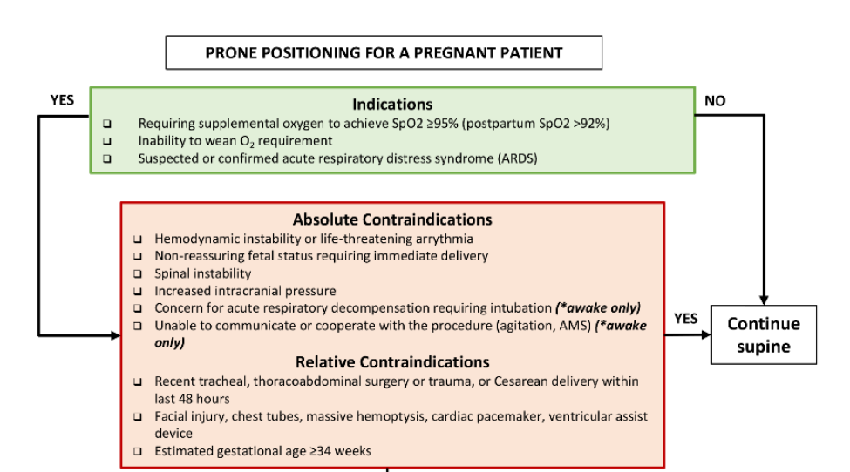

Slide 31
Thanks Q & A
Further references are included in additional slides and will be included in the minutes of the meeting

Slide 32
DTL Updates
KPPACC Med Rec
ePOLST
Fall Health Connect Updates

Slide 33
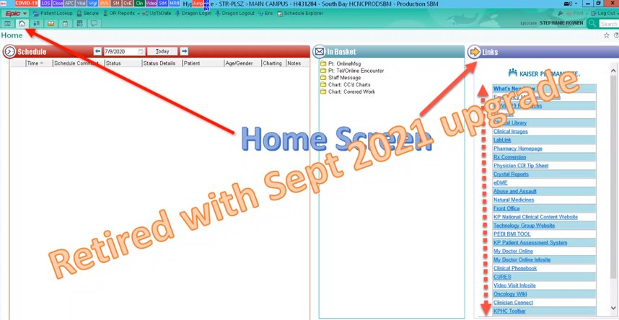

Slide 34
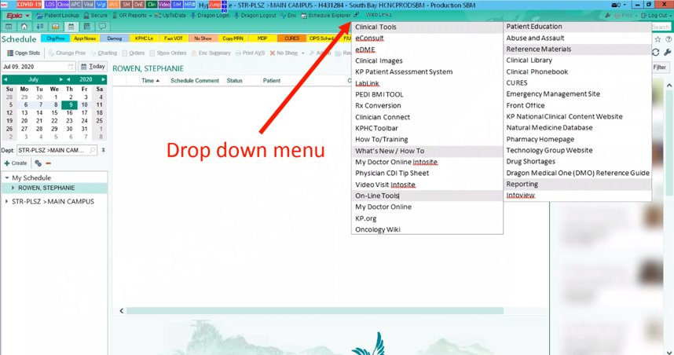

Slide 35
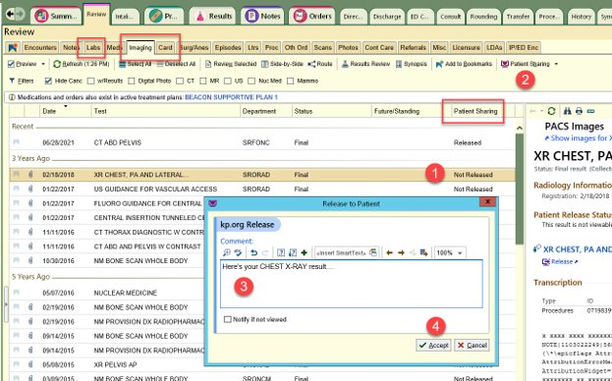

Slide 36
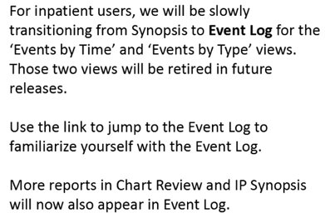
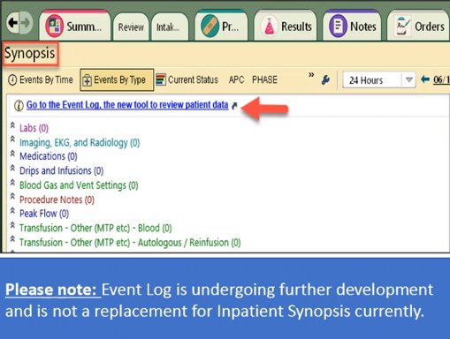
Feature Enriched Event Log

Slide 37
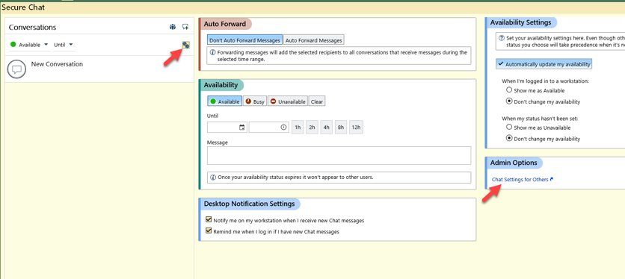
Chart Chat Admin Features

Slide 38
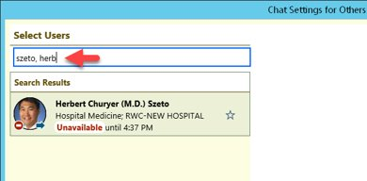
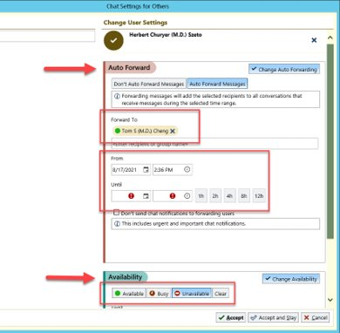

Slide 39
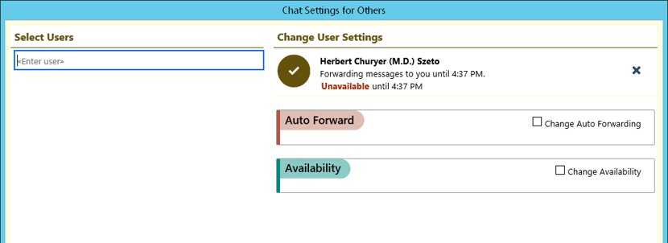

Slide 40
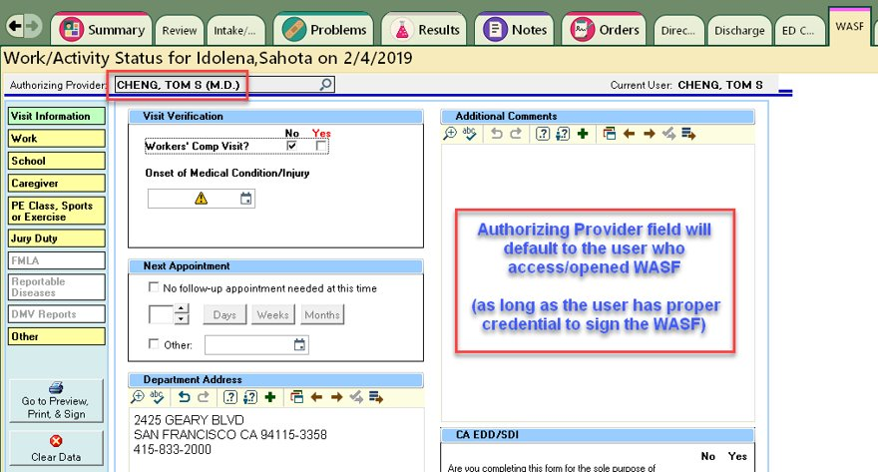

Slide 41
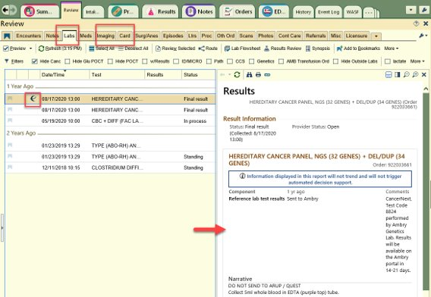
See Results Quickly from Outside Organizations

Slide 42
HBS Department Meeting Dr Sean Shargh
September 2021

Slide 43
Agenda
Psych Updates
ECT for inpatients
Clozapine Orderset
MPU Upgrade Workflow Reminder
ED Boarder Crosscover Workflow

Slide 44
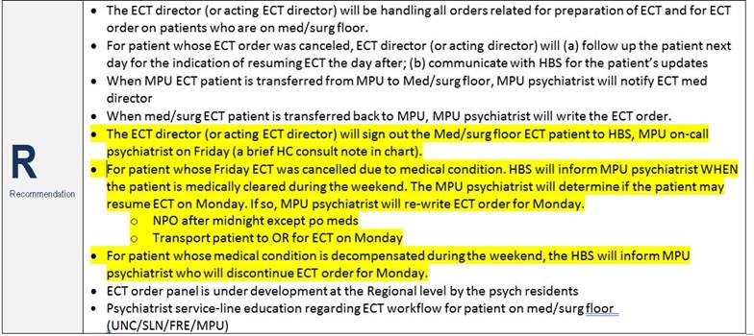
ECT for inpatients in FRE
Applies to patients admitted to Med-Surg/Med-Tele floors in FRE
Patients followed by Psychiatrist with recommendation for ECT therapy

Slide 45
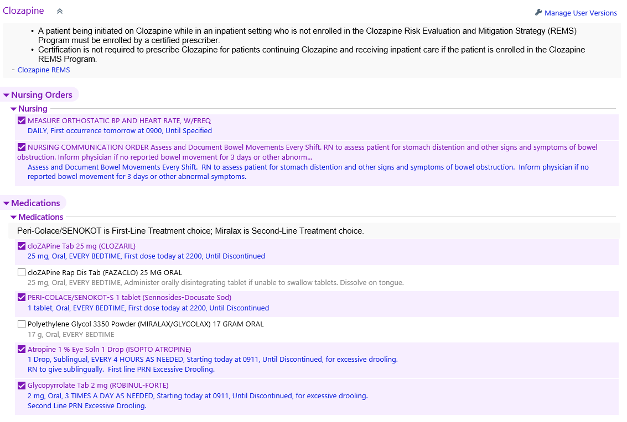
Clozapine Orderset
New orderset for Clozapine use established
Improved safety
Includes adjunctive meds
Likely initiated by Psychiatrist

Slide 46
MPU Upgrade Workflow - reminder
For any patient currently admitted to MPU (even if offsite in ECT suite)
Applies to all potential scenarios requiring a change in level of care
Rapid Response, Code Stroke, Code Blue
Treat MPU as a separate encounter!
1. Place discharge order (primary MPU team to later complete instructions/summary)
2. Place new admit order to new level of care [ICU, Med-Tele]
‘Admitting’ will need to be alerted to create new encounter
3. Complete H&P and Admit Orders
NEVER send patient to ER
During the day, MPU-HBS is expected to take the lead.
All other hours, crosscover HBS will be the lead.

Slide 47
ED Boarder Crosscover Workflow
Increasing numbers of ED Boarders have created confusion of appropriate covering crosscover HBS
RNs incorrectly calling/paging/chart chatting primary attending listed in HealthConnect, especially in the early morning hours (6am-8am)
For simplicity and consistency, all ED Boarder issues during crosccover hours will be directed to the ‘HBS Consultant/ED’ provider listed on WebServices
6pm to 8am
Tasked with addressing the issue, or directing to appropriate physician
Text-Page or Call depending on urgency (NO CHART CHAT!)
EMERGENCY ISSUES will continue to be addressed by the assigned ED physician

Slide 48
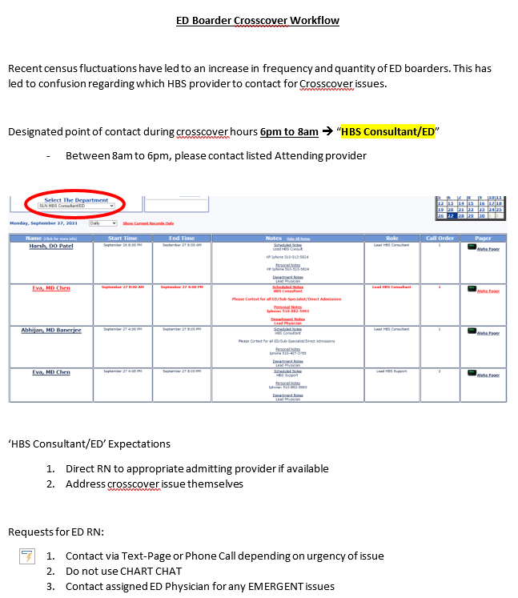

Slide 49
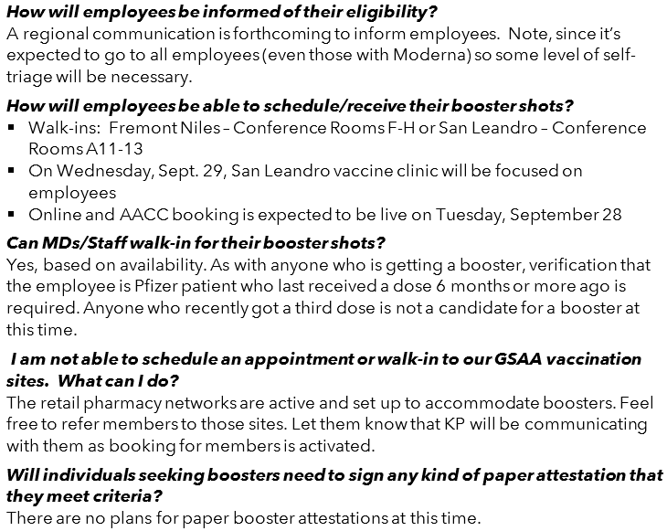
Pfizer Booster Shots

Slide 50
Meeting adjourned @ 7:05PM Thanks

